Slide 1
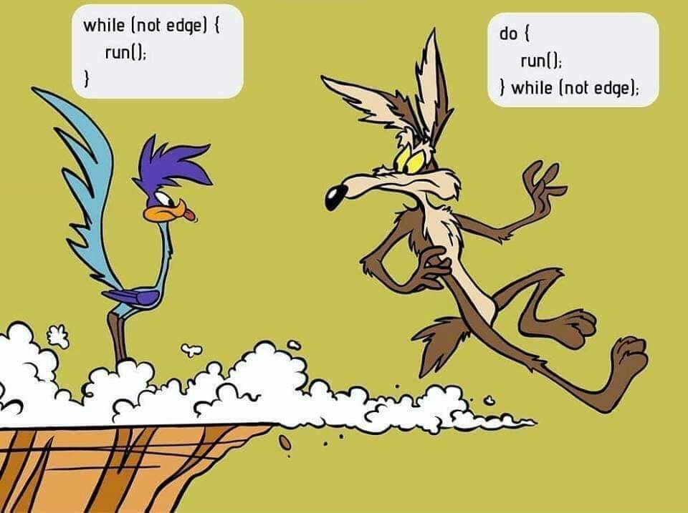
Repeating Control Structures
Loops: for, while, do while

Slide 2
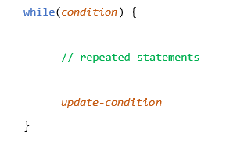
Basic Loop Structure
All loops use same structure
Control structure:
Keyword: while, do while, for
Condition – when to exit the loop
Control variable(s) - declared prior to loop
Conditional operator(s) - comparison and/or logic
Limiter value – literal or variable
Update condition:
Control variable(s) must change so that condition is eventually met
Repeated statements
Executable instructions that are repeated for each loop
Why consider condition as an exit conditional?

Slide 3
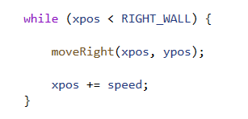
Conditional While Loop
Condition must be true to enter the loop
Repeat instructions while condition is true
Control variable "xpos" is declared and initialized prior to the loop
Limiter "RIGHT_WALL" is a constant expression that serves as the limit value
Comparison range-operator "<" sets the Boolean condition
Control variable "xpos" is updated each loop by the value in variable "speed"
Call to function "moveRight()" is repeated each loop

Slide 4
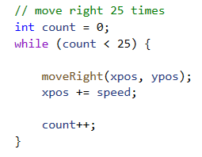
Counting While Loop
Counter control-variable is declared and initialized prior to loop
Range comparison operator sets Boolean condition
Control-variable value must meet Boolean condition relative to the limiter value to enter the loop loop
Control variable is updated each loop by the step-expression (incrementer "++", decrementer "--", or other expressions like control += 2)

Slide 5

For Loop
Counter control-variable is declared and initialized inside loop instruction
Range comparison operator sets Boolean condition
Step-expression indicates value to +/- control variable each loop
Example conditions:
[0..24]: control=0; control < 25; control++
[1..25]: control=1; control <=25; control++
[24..0]: control=24; control >=0; control--
[2,4,6,8]: control=2; control < 10; control += 2

Slide 6
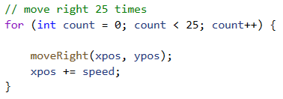
Counting For Loop
Control-variable "count" is declared and initialized to "0" inside FOR loop statement
Loop will run 25 times [0..24]
Count is updated by "1" each loop using the incrementer operator "++"
FOR loop compared to same WHILE counting loop
Guidelines for use of FOR loop:
Counting loop
Know how many times
Plan to execute every loop
Simple step-expression

Slide 7
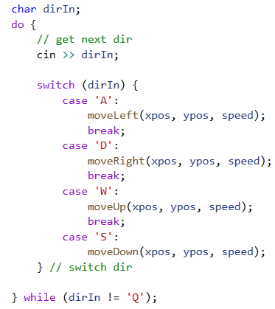
Do While Loop
Counter control-variable is declared prior to loop
Repeated statements are executed
Control variable is updated as part of execution
Conditional expression is evaluated at bottom of loop
Execution will occur at least once

Slide 8
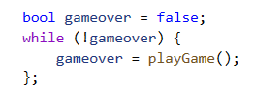
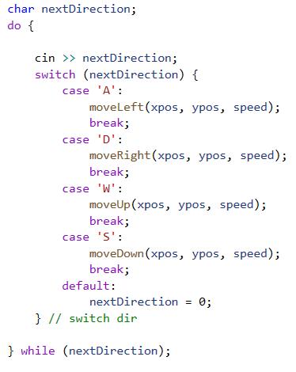
Flag Loop
Boolean variable/expression used as conditional
Name of variable should indicate condition, e.g.:
"continue=true; while(continue){}"
Logical NOT can be used with conditional, e.g.:
"exit=false; while (!exit){}"
Boolean variable/expression updated in repeated statements

Slide 9
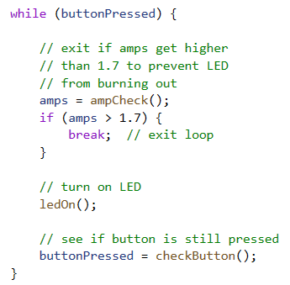
Breaking Out of Loops
Keyword "break" will terminate a loop or switch statement
execution returns to the next statement following the loop or switch statement
When executed in an inner nested-loop, will only exit inner-most loop
Use of keyword "break" to exit a loop should be avoided
May be used when exit condition is awkward to incorporate into conditional expression

Slide 10
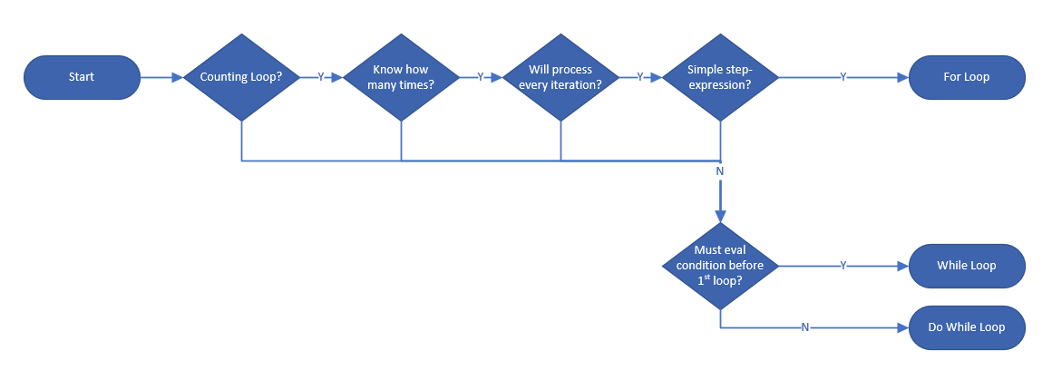
Loop-Type Decision Tree

